Slide 1

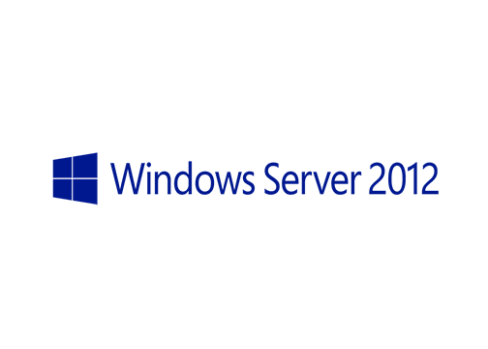
MegaSeries
Introduction to BranchCache

Slide 2
Intro
BranchCache first came about on Windows Server 2008R2 but saw some improvements on Windows Server 2012
It is a WAN bandwidth optimization feature especially meant for branch offices or smaller locations
Easy to set up with Group Policy and Powershell
Can be used for web servers and for file servers

Slide 3
BranchCache modes
Distributed mode : clients that are located in the branch office server the requested files to other clients in the office. Since client computers can connect to the central file server and get data and them server that data to other clients no server is required in the branch office
Hosted mode : a server is placed in the branch office. Cleints that want to download files from the central server will ask the cache server first. If it does not have that file, the client gets it from the central server and the cache server downloads the file from the computer

Slide 4
Misc details
A minimum latency can be configured so that BC is not used for links with low latency (default is 80ms)
In order for a file to be cached you will need at least 3 cleints to want to access it
BC is not used for files smaller than 64KB

Slide 5
https://www.youtube.com/channel/UCcZ-jLbPwNr8E_v9-65n8Iw https://github.com/itknowledge4

